Slide 1
CS 498
Virtual Reality
Design Processes
2/13/2019

Slide 2
Main Project Production Begins
Discovery (already done) |  | Discovery (2 week Milestone) |  | Pre Production (3 Week Milestone)
 |  |  |  |  |  | Production (9 Weeks)
 |  |  |  |  |  |  |  |  |  |  |  |  |  |  |  |  |  |  |  |  |  | Street
Proof Of Concept
Discovery: Milestone Due 2/22/19
Pre-Production: Milestone Due 3/8/19
Production
Beta Final
Alpha
Due 4/29/19
Discovery: Due Feb. 22, 2019 @11:59PM
High Vision Canvas: Use the template provided and the example to create a clear vision for your group project.
High Level Action Loop: Prepare an action loop that shows the main flow of your app/game.
Feature List: Use the Canvas and Action Loop to set the main features of your app/game. Use the Feature List template.
Team Milestone Plan: Create a simple team milestone for the 3-week pre-pro phase using the milestone template.
TAs will be set for the Projects on Thursday and they will help guide you through the Discovery Process

Slide 3
Vision Canvas
The layout is important
App/Game Name
Descriptive
Genre
World
Inspirations
Targets
User Experience
User Types
Foundational
Core Pillars
Core Systems
High Level Vision Canvas
App/Game Name
Inspirations (note what it is inspiring) | Genre (ex: RPG, Travel) | Core Pillars (in the form "Player can...") | Core Systems (ex: Save/Load or Combat) | User Experience (the emotion elicited)
 | IP/World (ex: Sci-fi, Beach)
 |  |  |  | Player Types (rank by priority)

Slide 4

Vision Canvas – Single Project/Level Version
Process for Completion:
Come up with an IDEA
Or
Get a strong understanding of what your project originator’s idea is.

Slide 5
Vision Canvas – Single Project/Level Version
Determine the Descriptors
Define the Genre
1st Person or 3rd, Travelogue, Shooter
Don’t include info about the world
Expectation is for standard Genre vernacular
Describe the World/Environment or IP
Information about the background of the world
Post Apocalyptic, Sci Fi, Japan, Beach , etc.
Licensed Intellectual Properties, etc.
Concepts
Narrative
These define the context, interactions and connections. They describe how the user interacts (ex: camera view) and relates (especially for a existing IP).
High Level Vision Canvas
App/Game Name
Inspirations (note what it is inspiring) | Genre (ex: RPG, Travel) | Core Pillars (in the form “User can...") | Core Systems (ex: Save/Load, Combat) | User Experience (the emotion elicited)
 | IP/World (ex: Sci-fi, Beach)
 |  |  |  | User Types (rank by priority)

Slide 6
Vision Canvas – Single Project/Level Version
Descriptors, continued:
Write down all your inspirations
Get specific
UI
Game play features / App comparisons
Tone (Tone Targets)
Style (Graphic look)
Lighting
This helps define the emotional elements the user will be experiencing.
High Level Vision Canvas
App/Game Name
Inspirations (note what it is inspiring) | Genre (ex: RPG, Travel) | Core Pillars (in the form “User can...") | Core Systems (ex: Save/Load, Combat) | User Experience (the emotion elicited)
 | IP/World (ex: Sci-fi, Beach)
 |  |  |  | User Types (rank by priority)

Slide 7
Vision Canvas – Single Project/Level Version
Target Information
User Experience
The emotional experience the user is having
Should relate/drive core pillars
User Types
Self defined
Should be descriptive
Should represent the key users
In descending order
Don’t go too broad
Make up your own descriptors
High Level Vision Canvas
App/Game Name
Inspirations (note what it is inspiring) | Genre (ex: RPG, Travel) | Core Pillars (in the form “User can...") | Core Systems (ex: Save/Load, Combat) | User Experience (the emotion elicited)
 | IP/World (ex: Sci-fi, Beach)
 |  |  |  | User Types (rank by priority)

Slide 8
Vision Canvas – Single Project/Level Version
Foundational Elements
Core Pillars
Features that drive the User Experience
In the form: “The User will …..”
Core Systems
Systems that support the core pillars and other key aspects of the app/game
Points to key low level systems
Examples: Traversal, UI, AI (if needed).
High Level Vision Canvas
App/Game Name
Inspirations (note what it is inspiring) | Genre (ex: RPG, Travel) | Core Pillars (in the form “User can...") | Core Systems (ex: Save/Load, Combat) | User Experience (the emotion elicited)
 | IP/World (ex: Sci-fi, Beach)
 |  |  |  | User Types (rank by priority)

Slide 9
Design Docs Process: Simple Action Loop
Win/Lose, no repeat
Lose, repeat
Start
S01
Home Base
S02
Mission
S03
Combat
S04
Death

Slide 10
Ergonomics and VR
Ergonomics: The science of refining the design of products to optimize them for human use
Ergonomics issues with VR
Physical discomfort (limitations of the human body)
Visual discomfort (limitations of stereoscopic viewing)
The weight of the HMD
The kinematic (repetitive motion) issues presented last design class
As Designers, what can we do to lessen the impact of VR ergonomic issues related to HMDs?
We need to define the target comfort zones
The optimal zone to put key content
The optimal zone for UI
The optimal zone to provide interactions within
The sum total of this will drive how our users experience our product

Slide 11
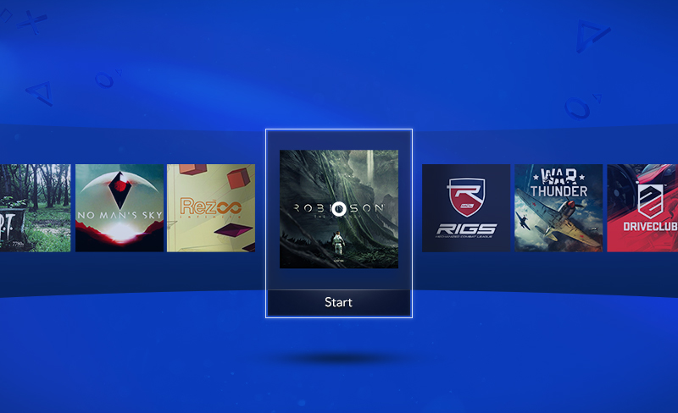
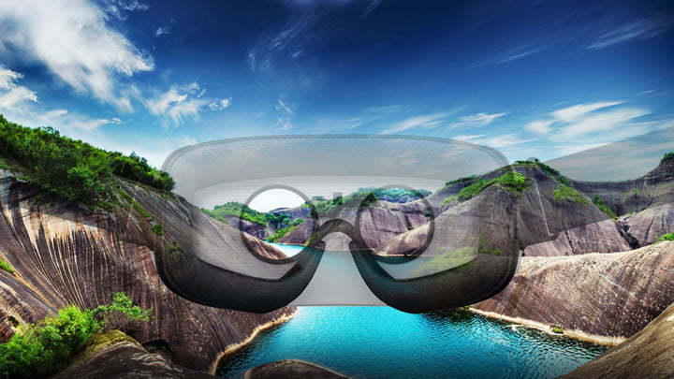
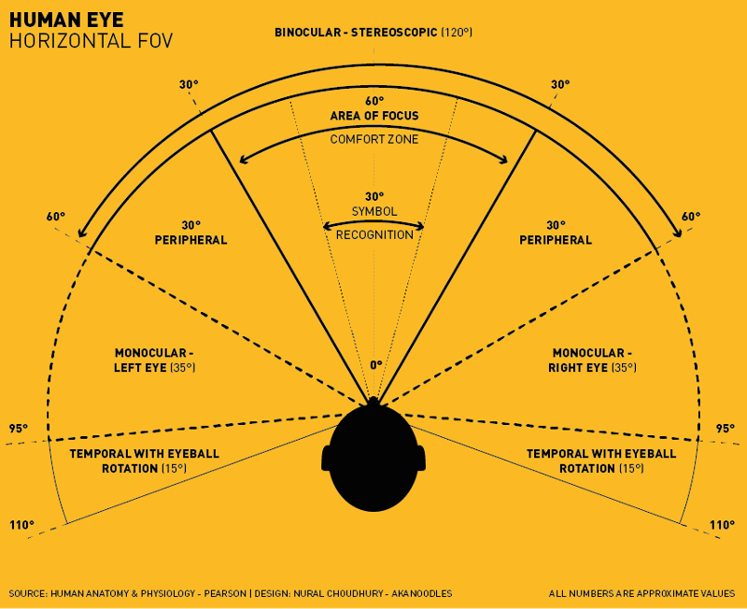
VR Design Specifics: Physical factors that impact Target Zones
Interesting physical limitations (Medich)
Standing: Easier to look left/right
Sitting: Easier to look up/down
Think about this in terms of platform
Head turning can be uncomfortable (Alger)
Recommended view frustum ±35°
Note that an Imax screen is 70° from center seat
Anything over 77° isn’t comfortable for viewing
The center 55° get the primary focus
This is important for specific kinds of applications
Showing a video
Using horizontal panels for user interface
© Nixson Sysanga

Slide 12
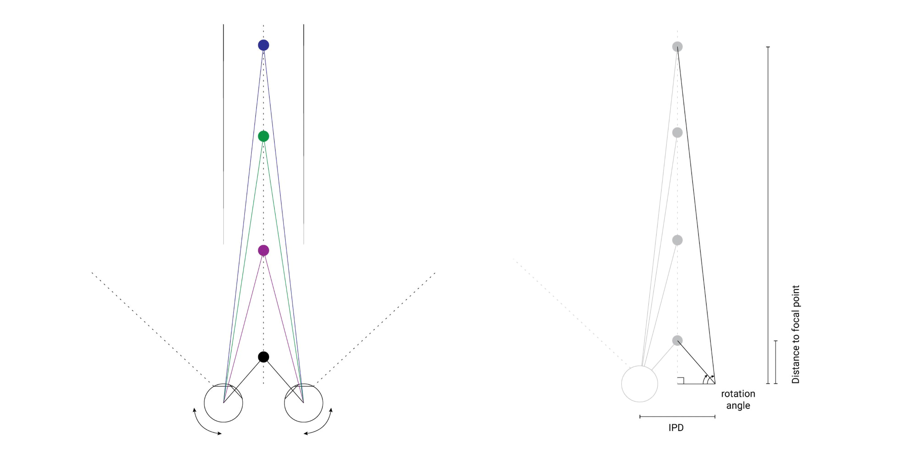
VR Design Ergonomics: Visual Discomfort - The eye’s convergence rotation angle Alger

Slide 13

VR Design Specifics: Joe Ludwig (Valve)
Best Content Depth in VR
Because of the convergence rotational angle of the eye
Anything within .5 meters of the head crosses the eyes
According to Oculus you shouldn’t put anything to read or focus on inside 1 meters
Content in VR shows best between 1 and 10 meters, 10 to 20 meters provides good VR
Anything beyond 20 meters and the eyes see the same image (flattening it out)

Slide 14


Slide 15


Slide 16
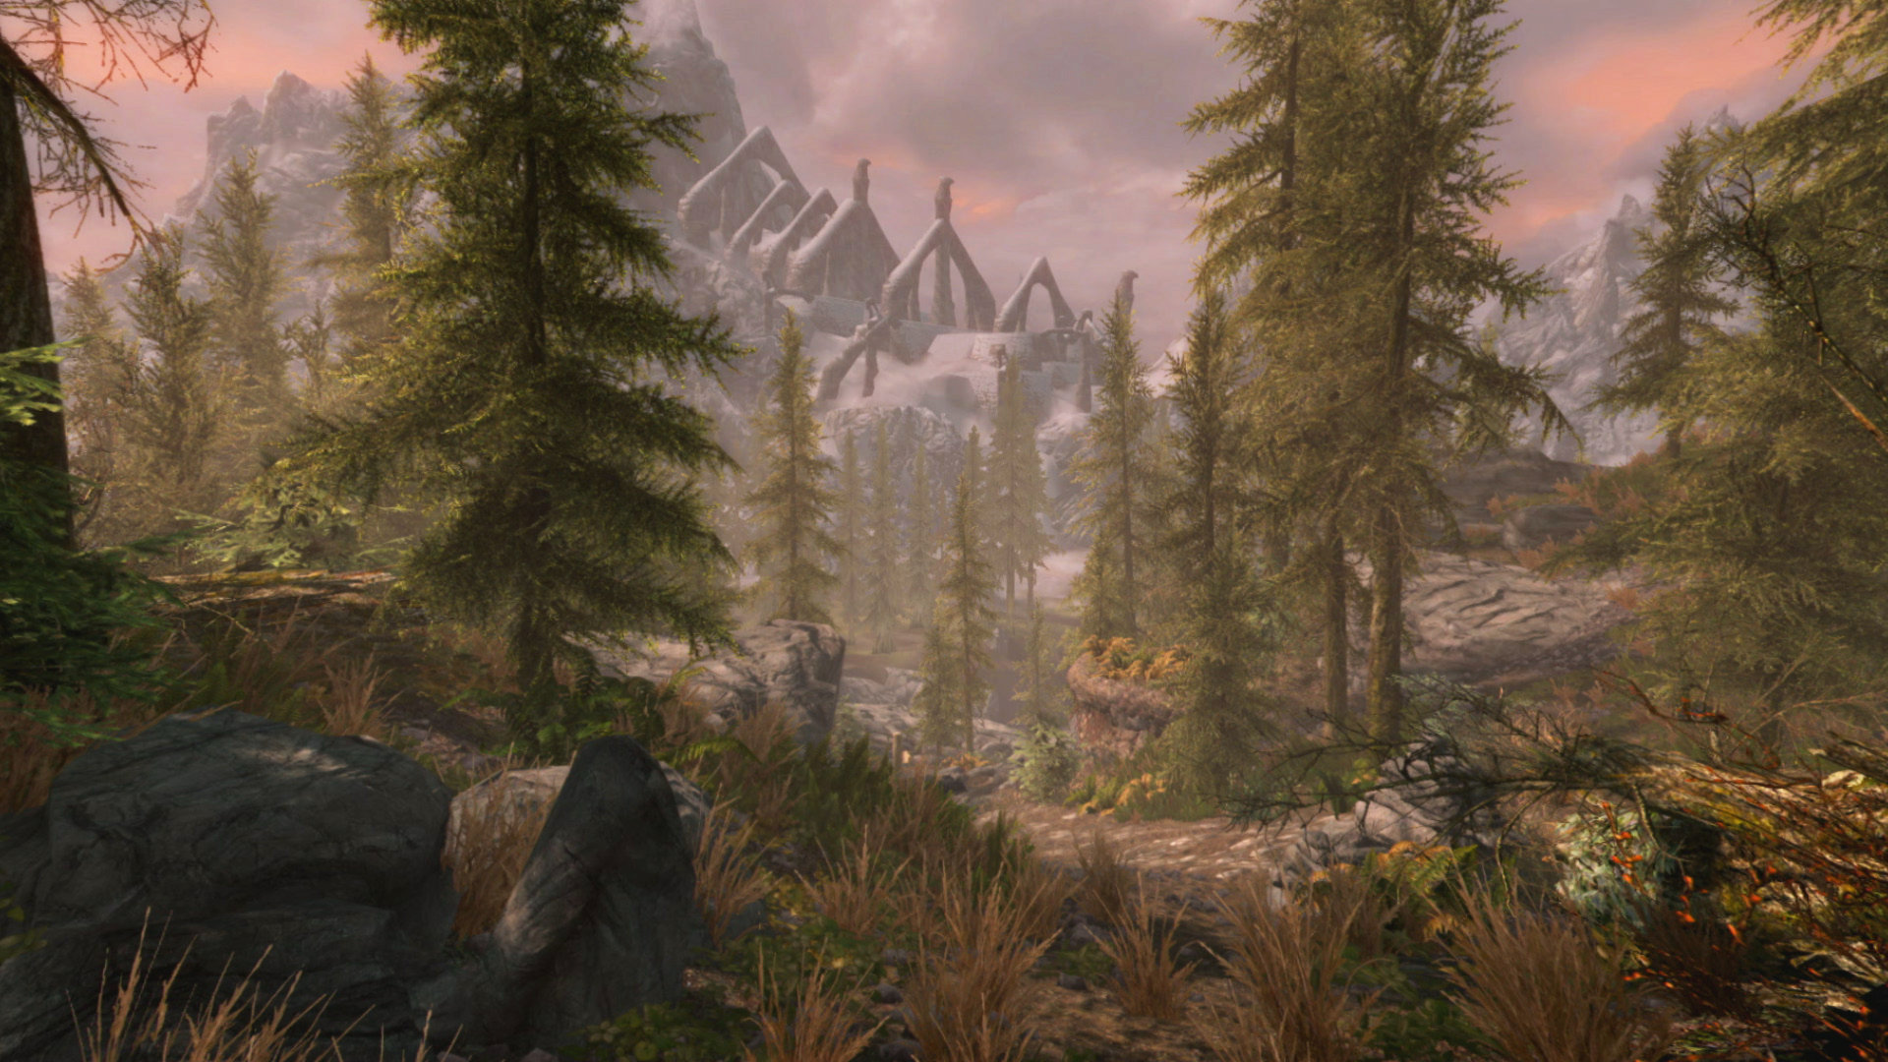
Bethesda Software: Skyrim VR

Slide 17
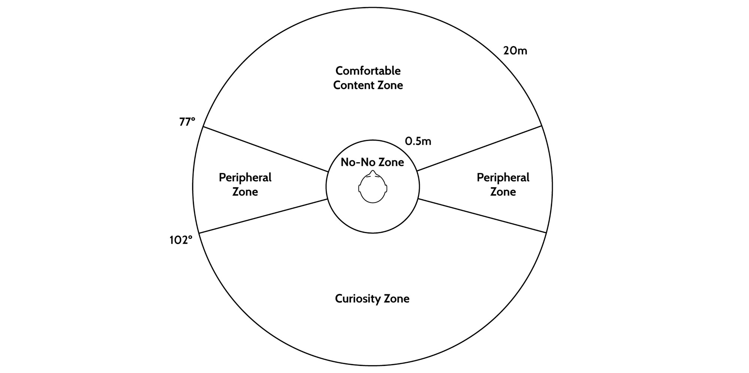
VR Design Ergonomics: User Information zones (Top Down) Alger

Slide 18
VR Design Specifics: Human posture & HMD weight Mike Agler (Google)
Users are impacted by the weight of HMDs
Weight of the average human head: 4500-5000g (10-11 pounds)
Rift: 470g (1.04 pounds)
Vive: 563g (1.24 pounds)
PSVR: 610g (1.34 pounds)
Ergonomic studies show that (if sitting) a monitor is should be 15° - 50° below horizon
Accounting For head tilt of 5 ° - 15°
And this doesn’t include the additional weight of an HMD

Slide 19
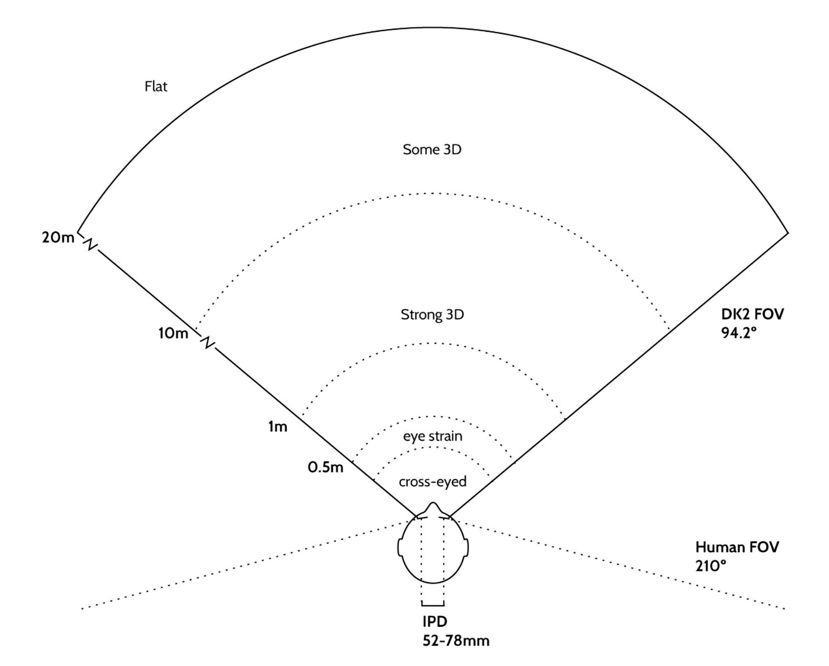
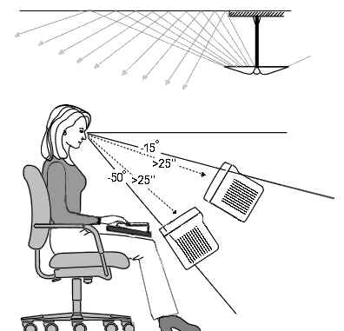
VR Design Specifics – Ergonomics Alger

Slide 20
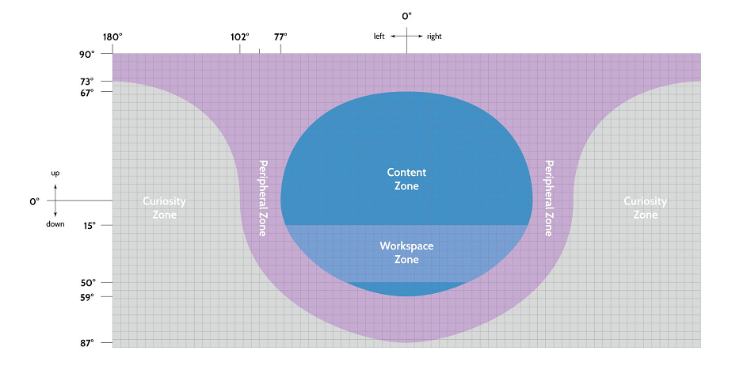
VR Design Ergonomics: User Information Zones (Out of the Eyes) Alger

Slide 21
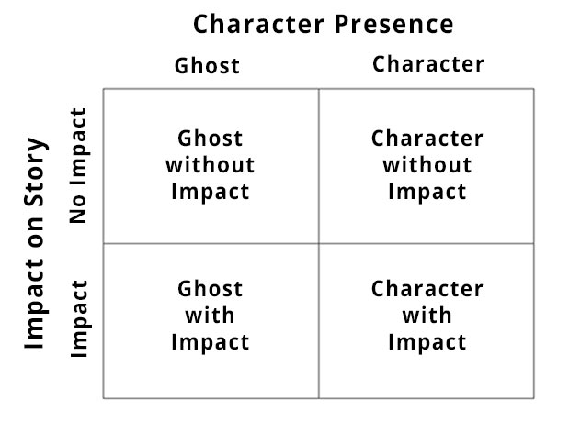

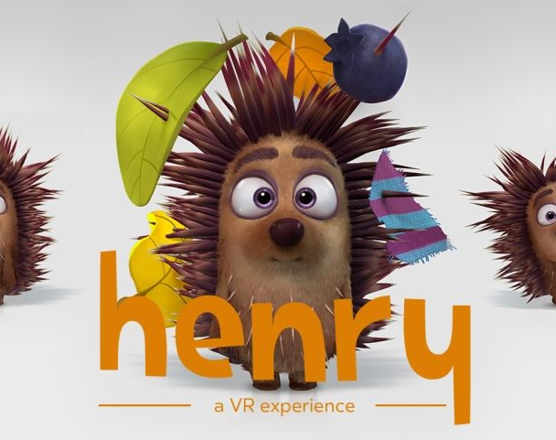
VR Design: General Concerns – Presence & Narrative
Mainstream media (movies, TV, books, most video games) have the “Fourth Wall”
Makes the user the observer
VR places the user in the experience
If 1st Person and the narrative doesn’t address the user as if present, it can be disturbing
You can make the user the observer but there is a loss of presence in that
VR movie makers have an issue with certain kinds of films
Henry (a short about a lonely hedgehog)
https://www.youtube.com/watch?v=IUY2yI5F16U
1:50 & 7:00
© D. Dolan

Slide 22
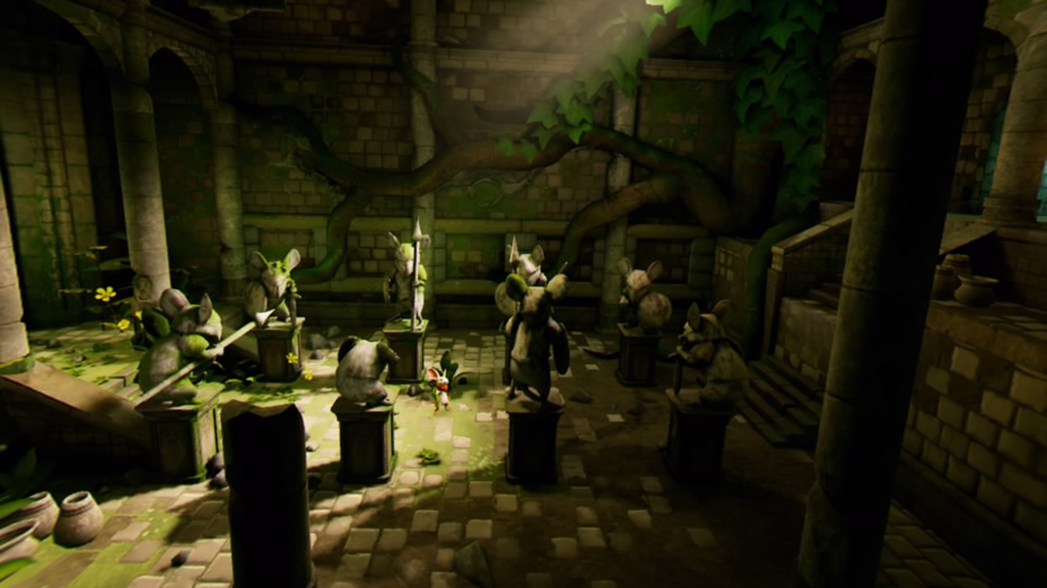
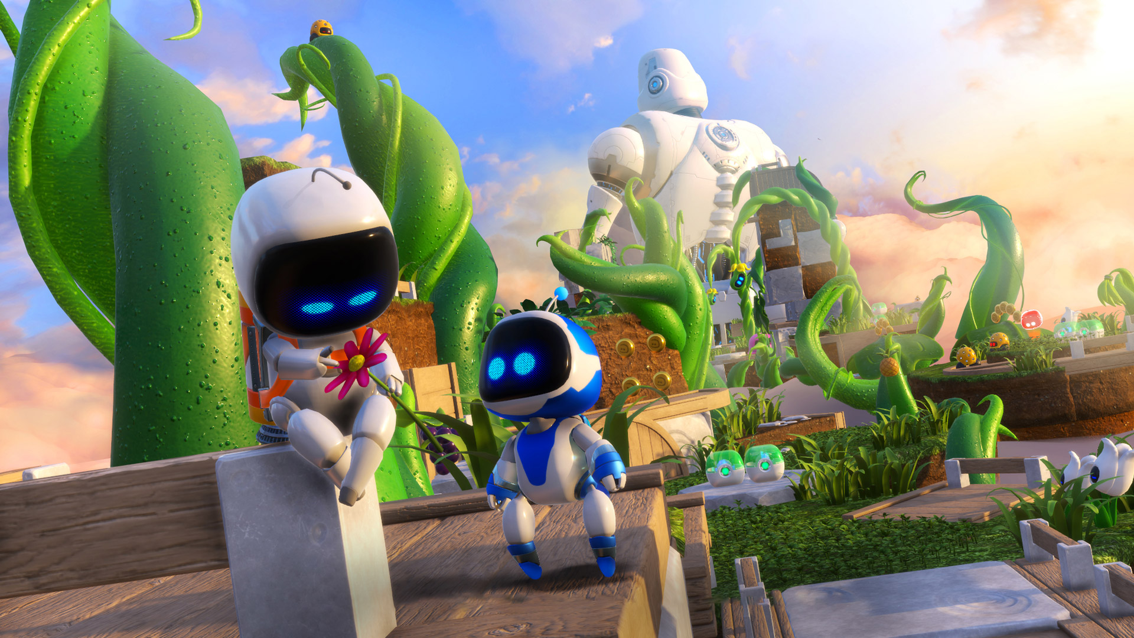
VR Design: General Concerns – Presence & Narrative
VR Games use 3rd person (Ghost with Impact) often
Moss and Astro Bot are very successful 3rd person games

Slide 23
VR Design: User Intent
Key aspect of User Experience
There are experiences you will want the user to have but what comes first?
What does the user want to do vs what do you want him to do?
How do you get the two elements to match?
Choice!
Don’t have one hierarchy of choices, give the user the freedom to choose their own path
Make sure the know what the choices are (get their attention).
Then Simplicity (it’s the old adage of KISS, Keep It Stupid Simple) – yeah I know it ain’t right
Take their intent and make it happen quickly and simply, don’t make the user work

Slide 24
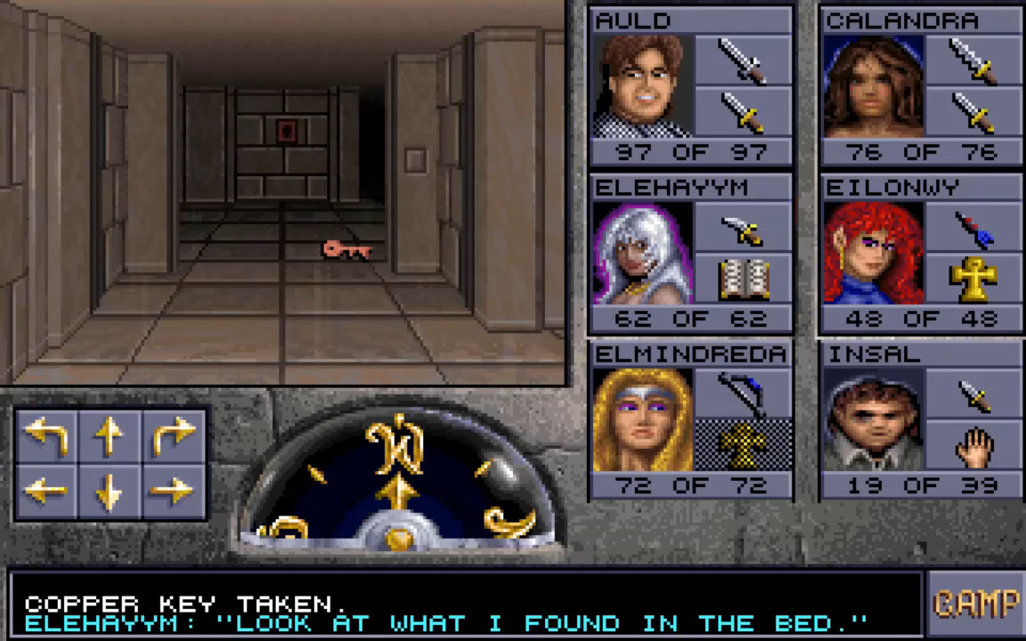

Slide 25
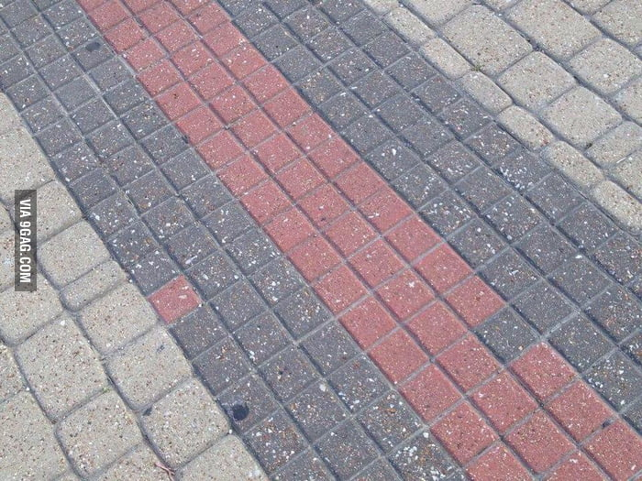

User Intent: Getting their Attention, so they can choose
Think about things that draw your attention in the real world
Pause, consider your user
Sound
Funnels, borders, elements that constrict flow
Things that standout against the background
Something out of place
Movement
https://www.hr.uillinois.edu/benefits/
https://accessibility.colostate.edu

Slide 26
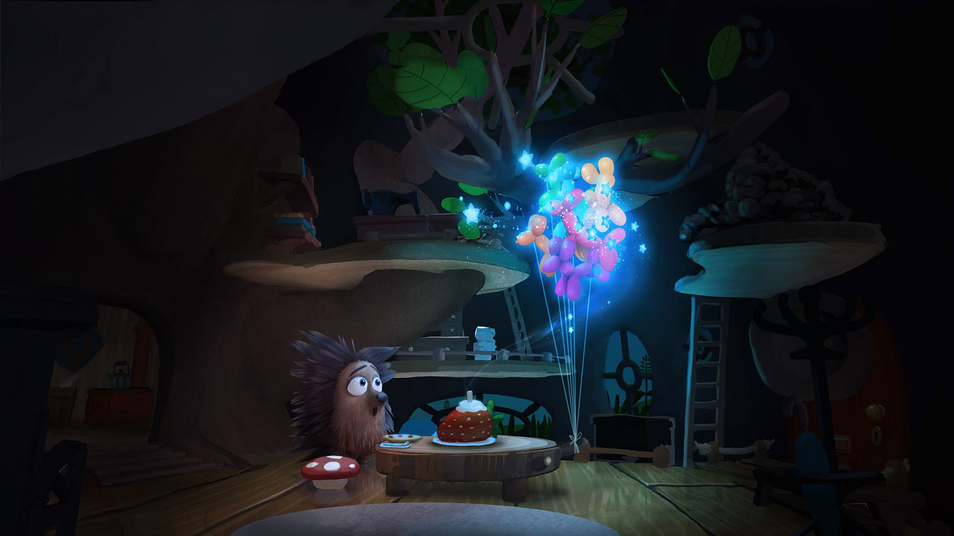
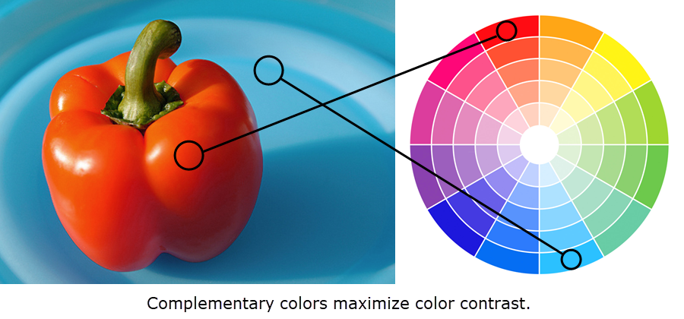
User Intent: Getting their Attention
Contrast is very powerful
Using Color is key
Lighting changes
Oculus Story Studio
https://accessibility.colostate.edu

Slide 27
Getting their Attention - Audio
Audio is hard but is key to a successful VR experience
The auditory systems are very sensitive and update faster than the visual systems
Audio from outside the experience will disconnect the user from your experience
Audio done right will draw the user in, affirming the experience
It can set mood
Supply the implication of content presence without the content (bird sounds)
Needs to provide the key details of the world and be localized
Techniques for successful VR audio
Audio matching content in the near, mid-range and far range zones
Ducking (lowing non-important audio)
Listening Angle (things outside your FOV are attenuated)
https://www.google.com/search?q=Back+to+dinosaur+Island+VR+demo&rlz=1C1CHBF_enUS802US802&source=lnms&tbm=isch&sa=X&ved=0ahUKEwjS4_Kr5q_gAhVL7YMKHd9RBLoQ_AUIECgD&biw=973&bih=935#imgrc=btjTyrFfrWCgLM:

